Slide 1

BANKING APPLICATION USING JDBC

Slide 2



PRESENTATION FLOW
1
Introduction
6
Database Schema
2
Project Objective
7
Flow of the Application
3
Features of the Banking Application
8
Challenges Faced
4
Technologies Used
9
Conclusion
5
System Architecture
10
Team Contributions

Slide 3
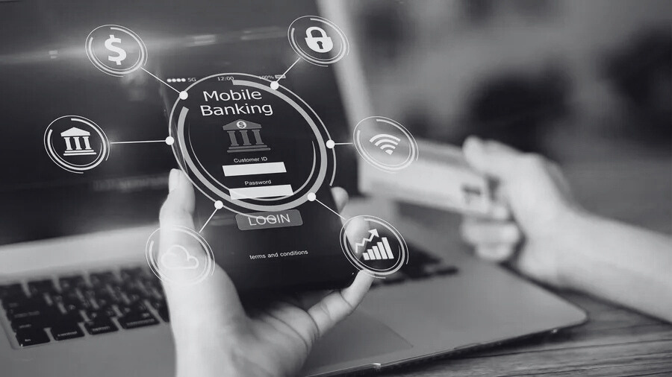
INTRODUCTION
What is the Project?
This project aims to develop a Banking Application that enables users to securely manage their accounts.
Users can perform banking tasks like checking balances, transferring money, and viewing transaction histories.
The system is designed with a focus on security, efficiency, and user experience.

Slide 4

Develop a robust Banking System with essential features
Create Account: Users can create an account with a unique 3-digit account number.
Login & Authentication: Secure login using the account number and password.
Check Balance: View current balance in real-time.
Transfer Money: Send money between accounts securely.
Transaction History: View all past transactions with timestamps.
PROJECT OBJECTIVE

Slide 5
Features of the Banking Application
Account Creation: Users can open an account by entering details and receiving a 3-digit unique account number.
Secure Login: Login with password protection.
Balance Inquiry: Users can check their current account balance anytime.
Money Transfer: Secure fund transfers between users.
Transaction History: Users can view all previous transactions with details like amount, sender, recipient, and date.
FEATURES OF THE BANKING APPLICATION

Slide 6




TECHNOLOGIES USED
JAVA
MySQL
JDBC
Java is a high-level, object-oriented programming language that's widely used for developing a variety of applications like this one.
MySQL is a popular open-source relational database management system (RDBMS) used for storing and organizing data. We use MYSQL to store data.
JDBC (Java Database Connectivity) is an API (Application Programming Interface) that provides a standard way for Java programs to interact with databases. It acts as a bridge between the Java application and the database system

Slide 7
SYSTEM ARCHITECTURE
Front-End
Back-End
JDBC
Framework
Java console-based interface.
MySQL database storing user account details and transactions.
Java Database Connectivity used to interact with MySQL for CRUD operations (Create, Read, Update, Delete).
JDBC (Java Database Connectivity)
Swing

Slide 8
DATABASE SCHEMA
account_number (INT)
Accounts Table:
account_number (INT): Unique identifier for each account.
name (VARCHAR): Name of the account holder.
password (VARCHAR): Password for secure login.
balance (DOUBLE): Account balance.
name (VARCHAR)
password (VARCHAR)
balance (DOUBLE)

Slide 9
DATABASE SCHEMA
transaction_id
Transactions Table:
transaction_id (INT, AUTO_INCREMENT): Unique transaction identifier.
account_from (INT): Sender’s account number.
account_to (INT): Recipient’s account number.
amount (DOUBLE): Amount transferred.
transaction_date (DATETIME): Date and time of the transaction.
account_from (INT)
account_to (INT):
amount (DOUBLE)

Slide 10
FLOW OF THE APPLICATION
ACCOUNT CREATION
USER LOGIN
Users enter details like name and initial balance, and the system generates a 3-digit account number.
Users input their account number and password to log in securely.
USER PANEL
TRANSACTION HISTORY
The User Panel is the core interface for account holders to interact with their banking accounts.
Users can view a history of all transactions made or received.

Slide 11
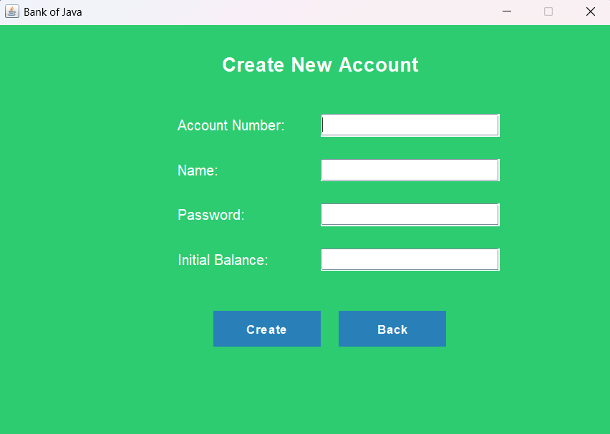
ACCOUNT CREATION

Slide 12
FLOW OF THE APPLICATION
ACCOUNT CREATION
USER LOGIN
Users enter details like name and initial balance, and the system generates a 3-digit account number.
Users input their account number and password to log in securely.
USER PANEL
TRANSACTION HISTORY
The User Panel is the core interface for account holders to interact with their banking accounts.
Users can view a history of all transactions made or received.

Slide 13
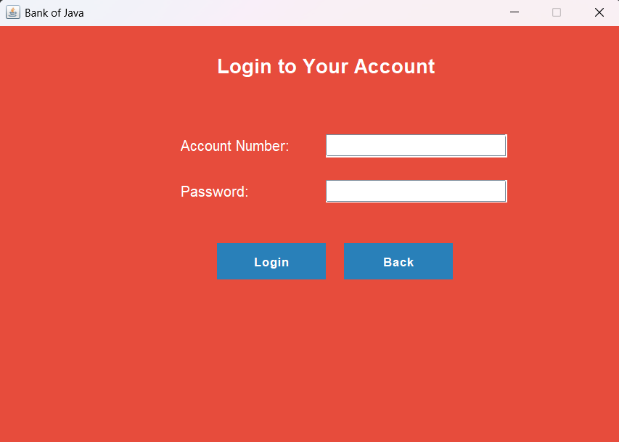
USER LOGIN

Slide 14
FLOW OF THE APPLICATION
ACCOUNT CREATION
USER LOGIN
Users enter details like name and initial balance, and the system generates a 3-digit account number.
Users input their account number and password to log in securely.
USER PANEL
TRANSACTION HISTORY
The User Panel is the core interface for account holders to interact with their banking accounts.
Users can view a history of all transactions made or received.

Slide 15
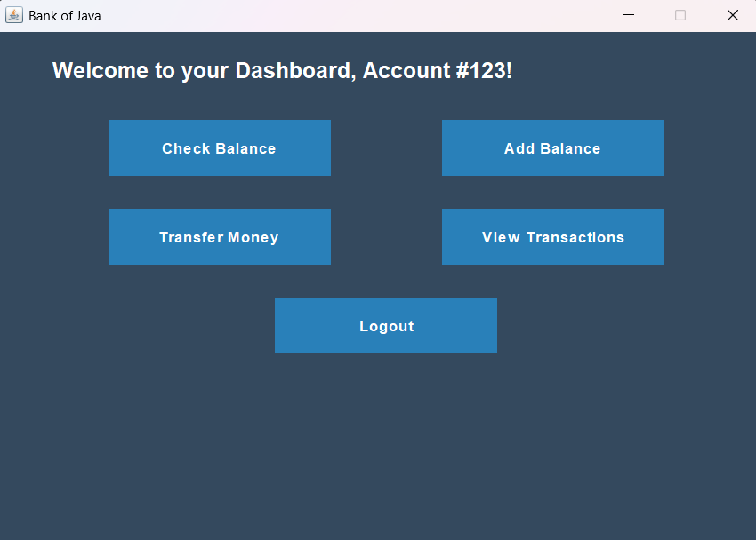
USER PANEL

Slide 16
FLOW OF THE APPLICATION
ACCOUNT CREATION
USER LOGIN
Users enter details like name and initial balance, and the system generates a 3-digit account number.
Users input their account number and password to log in securely.
USER PANEL
TRANSACTION HISTORY
The User Panel is the core interface for account holders to interact with their banking accounts.
Users can view a history of all transactions made or received.

Slide 17
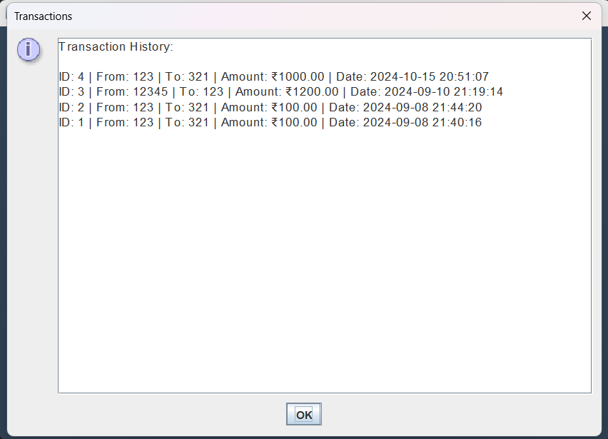
TRANSACTION HISTORY

Slide 18
CHALLENGES FACED
JDBC Integration
Error Handling
Establishing a seamless connection between the Java application and MySQL database.
Managing errors during transactions and ensuring data integrity.
Data Security
User Experience
Ensuring account information is stored securely and preventing unauthorized access.
Designing a simple, user-friendly interface for a smooth user experience.

Slide 19


CODE - GITHUB REPOSITORY
Scan the QR Code to Visit the GitHub Repository
This repository contains the full source code for our Banking Application using JDBC project.
The code is well-documented and organized for easy navigation.
Contributions and improvements are welcome!
https://github.com/YashGarg1122/BankOfJava.git

Slide 20
CONCLUSION
This project successfully achieved the objective of creating a secure and functional Banking Application using JDBC.
The system allows users to create accounts, manage balances, and perform transactions efficiently.
Our team gained valuable experience in JDBC, database management, and error handling, contributing to real-world software development skills.

Slide 21
TEAM CONTRIBUTIONS
Thank you for your time! Reach out to us for questions.
DHRUV GUPTA
APURVA BANSAL
RITESH KUMAR SINHA
YASH GARG
Lead developer, account management.
Transaction handling, JDBC integration
Error handling, testing, database design
Interface design, project management
SAURAV AGRAWAL
ANSHUL SIROHI
Documentation, flow diagrams
Git management, database setup

Slide 22
THANK YOU
for your time and attention

